Slide 1
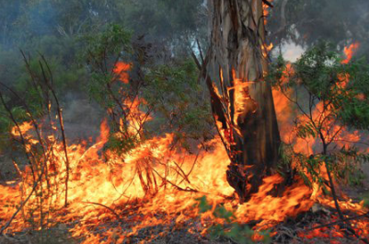
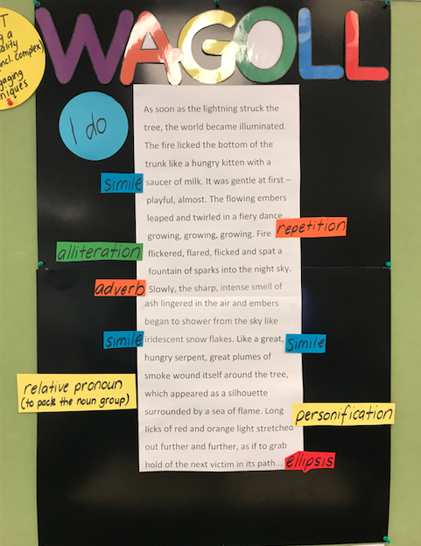
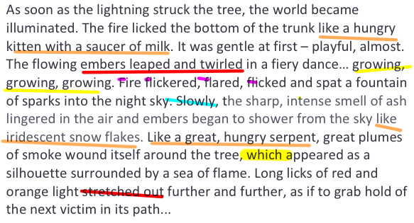
Notes:
As soon as the lightning struck the tree, the world became illuminated. The fire licked the bottom of the trunk like a hungry kitten with a saucer of milk. It was gentle at first – playful, almost. The flowing embers leaped and twirled in a fiery dance… growing, growing, growing. Fire flickered, flared, flicked and spat a fountain of sparks into the night sky. Slowly, the sharp, intense smell of ash lingered in the air and embers began to shower from the sky like iridescent snow flakes. Like a great, hungry serpent, great plumes of smoke wound itself around the tree, which appeared as a silhouette surrounded by a sea of flame. Long licks of red and orange light stretched out further and further, as if to grab hold of the next victim in its path…

